Slide 1
Software Quality Assurance and Testing
Lecture - 06
Harish Aggarwal

Slide 2
Black Box Testing
Methodologies

Slide 3
Re-Cap
Lecture - 01
Definitions – S/W Quality, S/W Quality Assurance
Importance of QA
Causes of Defects
Business Models in S/W
S/W Cost, Quality Cost
Quality culture
Lecture - 02
Software Quality Models
McCall, IEEE 1061, ISO 25000 Series
Quality Requirements
Quality of Requirements
Frameworks
ISO/IEC/IEEE 12207 - Software Life Cycle Processes
Lecture - 03
Frameworks
CMMI-Development
ITIL Framework
Other Frameworks
Lecture - 04
ISO 25010 – Quality Attributes
Functional Suitability, Performance Efficiency, Compatibility, Usability, Reliability, Security, Maintainability, Portability
Lecture - 05
Software Testing Fundamentals
Software Verification and Validation
Types of Testing - Black Box, White Box Testing
Test Levels and Types –
Unit, Integration, System Testing

Slide 4
Agenda
Test Design Techniques
Combinatorial Testing
Boundary Value Analysis
Equivalence Class Partitioning

Slide 5
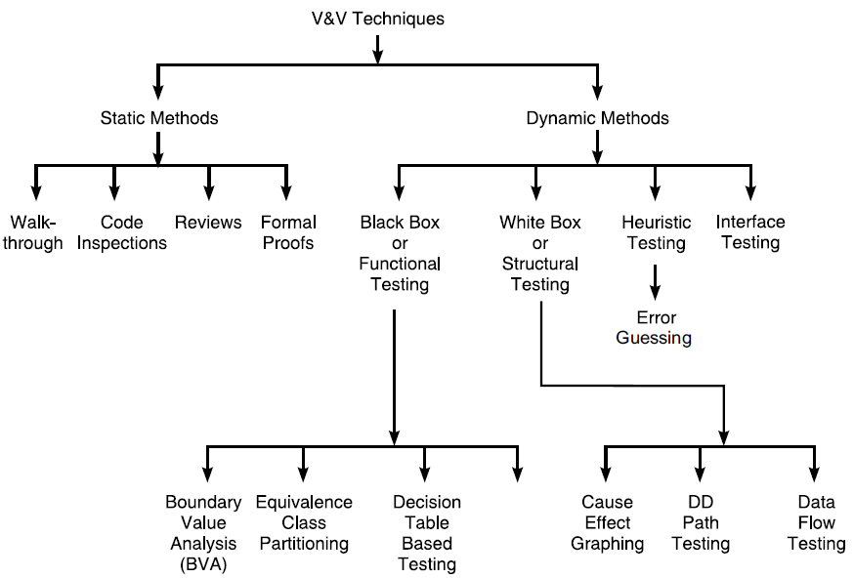
Software Testing
V&V Techniques
Together Verification and Validation forms the complete Testing

Slide 6
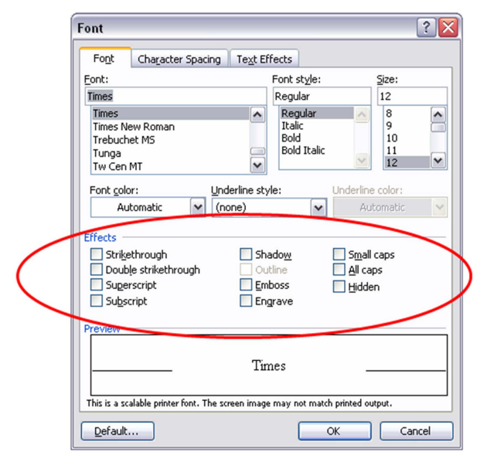
Need of Combinatorial
Possible Test case
2¹⁰ = 1,024

Slide 7
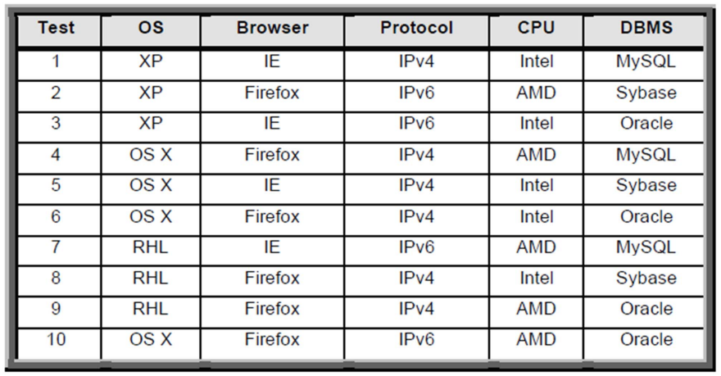
Need of Combinatorial
OS - XP, OS X, RHL (3)
Browser - IE, Firefox (2)
Protocol - IPV4, IPV6 (2)
CPU - Intel, AMD (2)
DBMS - Sybase, Oracle, MySQL (3)
Total Possible Test case 3*2*2*2*3 = 72

Slide 8
Model the input
Fault Model (Interaction Faults)
A t-way interaction fault is a fault that is triggered by a certain combination of t input values.
A simple fault is a t-way fault where t = 1
A pairwise fault is a t-way fault where t = 2.
In practice, a majority of software faults consist of simple and pairwise faults.
Unique combinations
Latin Squares
Pairwise Testing
Orthogonal Array

Slide 9
Model the input
P1 = (A,B)
P2 = (1,2,3)
P3 = (X, Y)
Total Test Cases – 12
Simple Fault - Each parameter value must be covered in at least
one test case

Slide 10
Model the input
P1 = (A,B)
P2 = (1,2,3)
P3 = (X, Y)
Total Test Cases – 12
2-Way Fault - Every combination of values of two parameters are covered in at least one test case.
Also called as Pairwise coverage

Slide 11
Model the input
P1 = (A,B)
P2 = (1,2,3)
P3 = (X, Y)
Total Test Cases – 12
Base choice coverage –
For each parameter, one of the possible values is designated as a base choice of the parameter
A base test is formed by using the base choice for each parameter
Subsequent tests are chosen by holding all base choices constant, except for one, which is replaced using a non-base choice of the corresponding parameter:

Slide 12
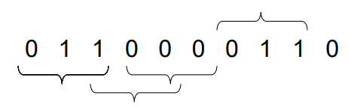
3-Way coverage
3-way coverage -
10C3 = 120
Thus, there would be 120*2³ = 960 Test case
Since 3 Triples can be packed in each Test case, we need 320 TC

Slide 13
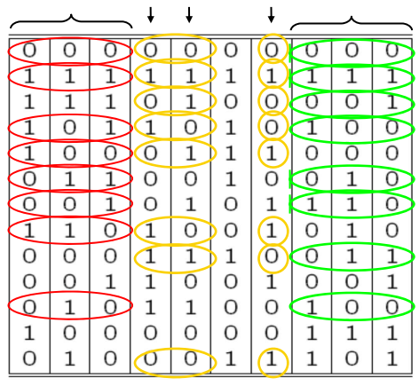
3-Way coverage
3-way coverage -
Actually, only 13 tests cases are needed to cover 960 TC
Finding covering arrays is NP hard.

Slide 14
Need of Combinatorial
OS - XP, OS X, RHL (3)
Browser - IE, Firefox (2)
Protocol - IPV4, IPV6 (2)
CPU - Intel, AMD (2)
DBMS - Sybase, Oracle, MySQL (3)
Total Possible Test case 3*2*2*2*3 = 72

Slide 15
Pairwise Testing
Pairwise Testing is a type of software testing in which permutation and combination method is used to test the software. Pairwise testing is used to test all the possible discrete combinations of the parameters involved.
Pairwise testing is a P&C based method, in which to test a system or an application, for each pair of input parameters of a system, all possible discrete combinations of the parameters are tested. By using the conventional or exhaustive testing approach it may be hard to test the system but by using the permutation and combination method it can be easily done.

Slide 16
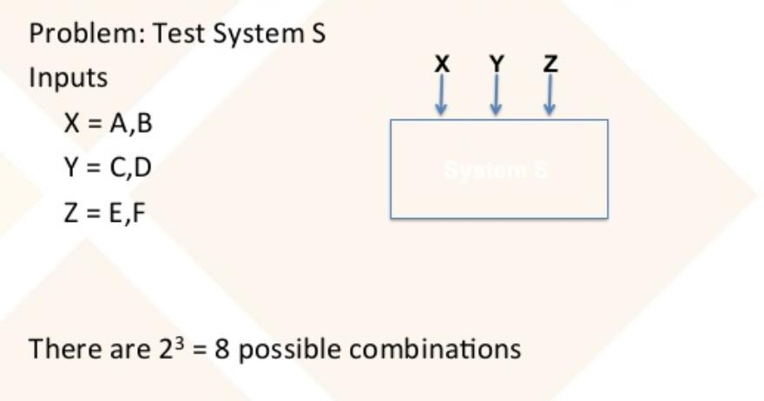
Pairwise Testing (Example)

Slide 17
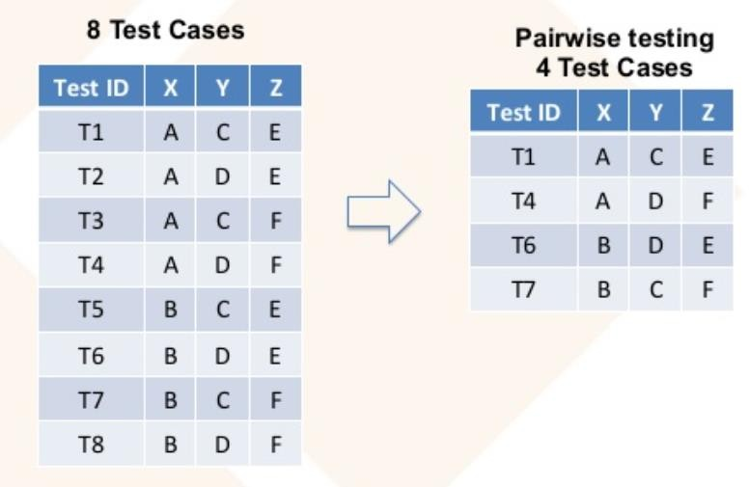
Pairwise Testing (Example)

Slide 18
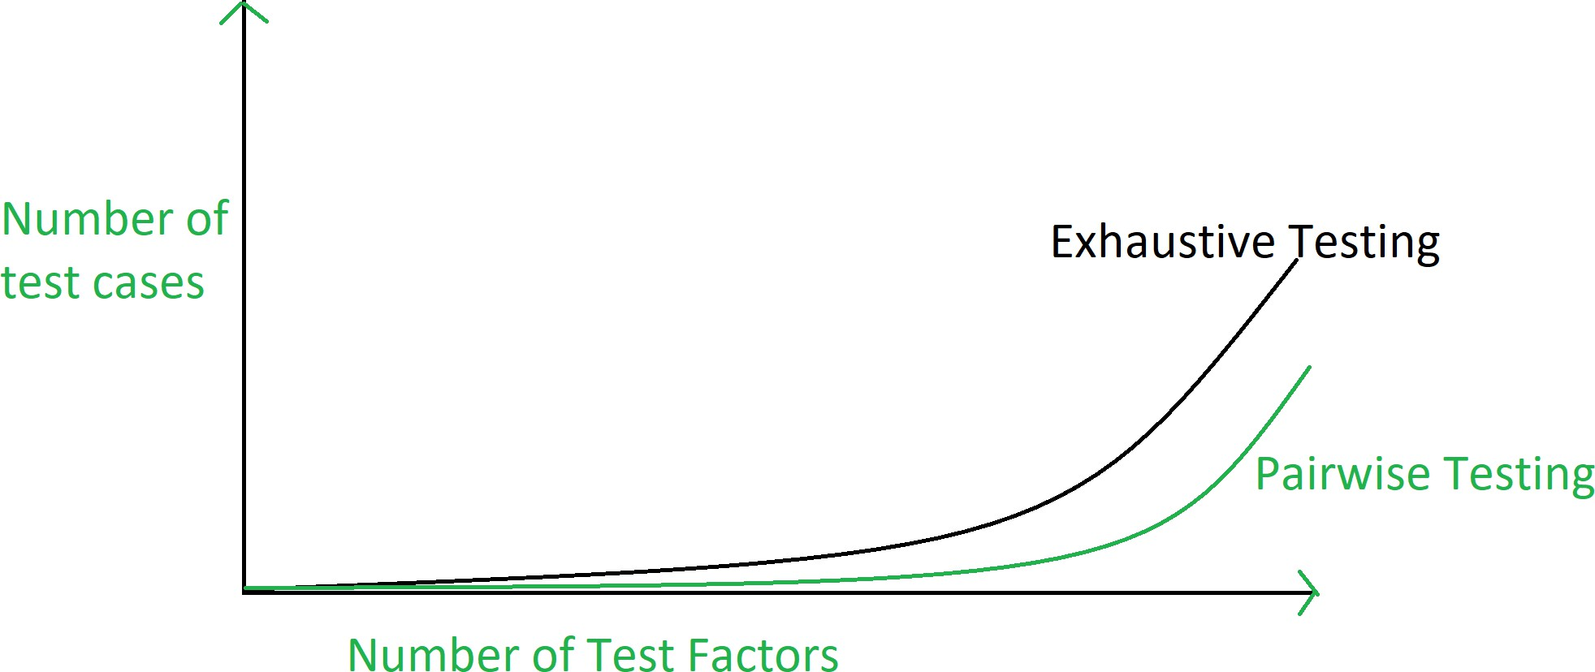
Pairwise Testing

Slide 19
Advantages of Pairwise Testing
Reduces the number of execution of test cases.
Increases the test coverage almost up to hundred percentage.
Increases the defect detection ratio.
Takes less time to complete the execution of the test suite
Reduces the overall testing budget for a project.

Slide 20
Disadvantages of Pairwise Testing
Not beneficial if the values of the variables are inappropriate.
It is possible to miss the highly probable combination while selecting the test data.
Defect yield ratio may be reduced if a combination is missed.
Not useful if combinations of variables are not understood correctly.

Slide 21
Coverage
Studies such as “Estimating t-Way Fault Profile Evolution During Testing” and “Practical Combinatorial Testing” (presented by the National Institute of Standards and Technology in 2017 and 2010 respectively) indicate that the vast majority of defects (67%-93%) related to input values are due to a problem in either one parameter value (single-value fault) or a combination of two parameter values (2-way interaction fault).
NIST research showed that most software bugs and failures are caused by one or two parameters, with progressively fewer by three or more, which means that combinatorial testing can provide more efficient fault detection than conventional methods. Multiple studies have shown fault detection equal to exhaustive testing with a 20X to 700X reduction in test set size. New algorithms compressing combinations into a small number of tests have made this method practical for industrial use, providing better testing at lower cost. (NIST)

Slide 22
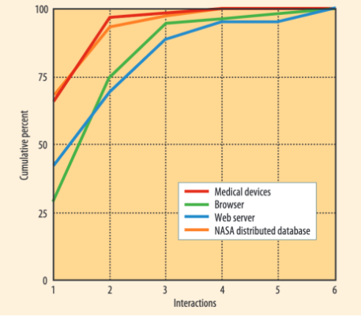
Coverage

Slide 23
Black Box Testing
BVA
Boundary Value Analysis
Software is treated as a Black Box.
Combination of Input is decided.
Actual o/p is matched with expected o/p
Test case with {min, min+, nom, max–, max} values

Slide 24
BVA – Explore the types
Example
A program takes 2 inputs x1 and x2
a <= x1 <= b
c <= x2 <= d
We have the intervals
[a, b] ← x1
[c, d] ← x2
d
c
BVA test cases for a function of two variables – single fault assumption
4n+1 test cases
a
b

Slide 25
BVA – Worst Case Analysis
d
d
c
c
a
b
a
b
Worst Case
Robust Worst Case

Slide 26
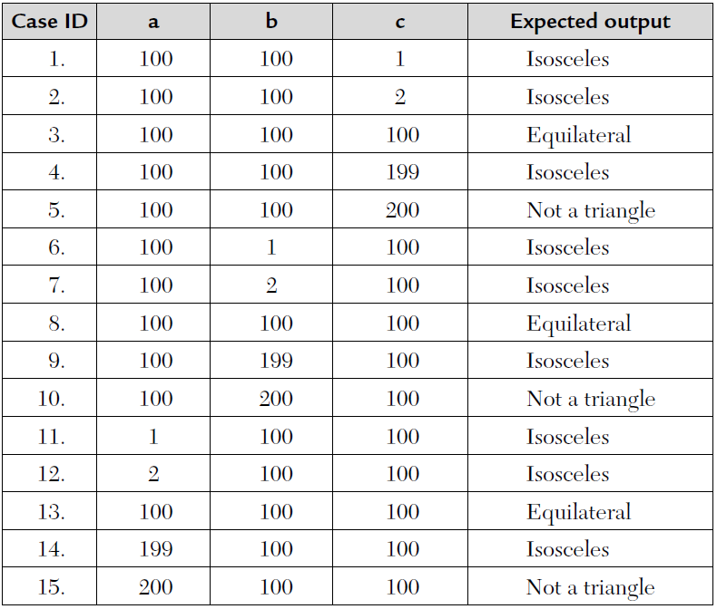
Black Box Testing
BVA (Boundary Value Analysis)
Example
The triangle program accepts three integers, a, b, and c, as input. These are taken to be the sides of a triangle. The integers a, b, and c must satisfy the following conditions:
C1: 1 ≤ a ≤ 200 C4: a < b + c
C2: 1 ≤ b ≤ 200 C5: b < a + c
C3: 1 ≤ c ≤ 200 C6: c < a + b
The output of the program may be:
Equilateral, Isosceles, Scalene, or
“NOT-A-TRIANGLE.
Test Case 3, 8, 13 are same and hence 8, 13 are redundant and can be removed.
Total Test cases are 4n+1 = 4*3+1 = 13
Ref : R2 - Software Testing By RAJIV CHOPRA.

Slide 27
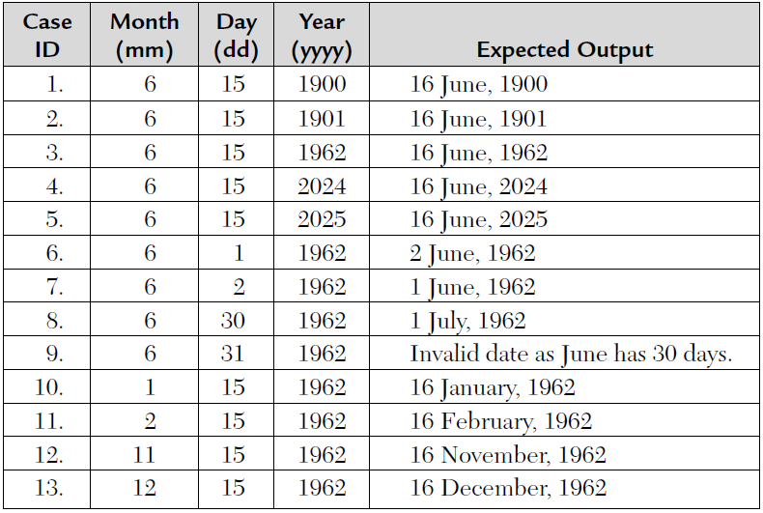
Black Box Testing
BVA (Boundary Value Analysis)
Next Date is a function of three variables: month, date, and year. It returns the date of next day as output. It reads current date as
input date. The conditions are:
C1: 1 ≤ month ≤ 12
C2: 1 ≤ day ≤ 31
C3: 1900 ≤ year ≤ 2025
If any of conditions C1, C2, or C3 fails, then this function produces an output “value of month not in the range 1...12.”
Because many combinations of dates exist this function just displays one message:
“Invalid Input Date.”
Test cases have not covered Leap Year, 30 day months, etc

Slide 28
Equivalence class Testing
The input and the output domain is divided into a finite number of equivalence classes.
Eg select one representative of each class and test our program against it.
Four types of equivalence class testing are discussed :
Weak normal equivalence class testing – All Valid inputs
Strong normal equivalence class testing - All Valid inputs, one from each sub-interval equivalence class
Weak robust equivalence class testing – One invalid input
Strong robust equivalence class testing – More than one invalid input

Slide 29
EC – Weak Normal
One variable from each EC
A systematic way of deriving the EC
Same number of weak EC test cases as classes in the partition with the largest number of subsets
Based on a single fault assumption
Testing valid subdomains
Assumption
Input variables are independent
One dimensional valid subdomains
Selects tests from one dimensional (one variable) subdomains
g
f
e
a
b
c
d

Slide 30
EC – Strong Normal
Based on a multiple fault assumption
We derive test cases out of the Cartesian product of equivalence classes
Notion of “completeness”
Testing valid subdomains
Assumption
Input variables are related
Multidimensional subdomains. (Example)
Test selection: Select at least one test from each of the multidimensional sub domain
g
f
e
a
b
c
d

Slide 31
EC – Weak Robust
Weak Robust is counterintuitive.
Robust comes from the consideration of invalid values
Weak refers to the single fault assumption
A test case should have one invalid value and the remaining values should be valid
One dimensional invalid subdomains
g
f
e
a
b
c
d

Slide 32
EC – Strong Robust
Robust comes from consideration of invalid values for inputs
Strong refers to the multiple fault assumption
g
f
e
a
b
c
d

Slide 33

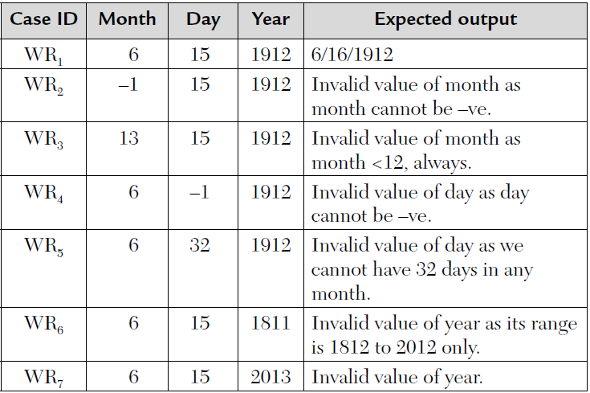
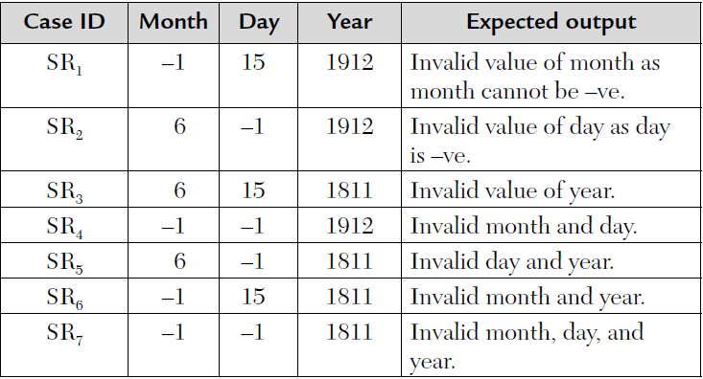
Black Box Testing
Equivalence Class Testing
Next Date is a function of three variables: month, date, and year. It returns the date of next day as output. It reads current date as input date. The conditions are:
M1: 1 ≤ month ≤ 12
D1: 1 ≤ day ≤ 31
Y1: 1812 ≤ year ≤ 2012

Slide 34
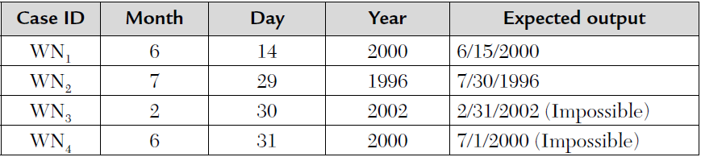
Black Box Testing
Equivalence Class Testing
Next Date is a function of three variables: month, date, and year. It returns the date of next day as output. It reads current date as input date. The conditions are:
M1 = {month: month has 31 days} (1,3,5,7,8,10,12)
M2 = {month: month has 30 days} (4,6,9,11)
M3 = {month: month is February} (2)
D1 = {day: 1 ≤ day ≤ 28}
D2 = {day: day = 29}
D3 = {day: day = 30}
D4 = {day: day = 31}
Y1 = {year: year = 2000}
Y2 = {year: year is a leap year}
Y3 = {year: year is a common year}

Slide 35
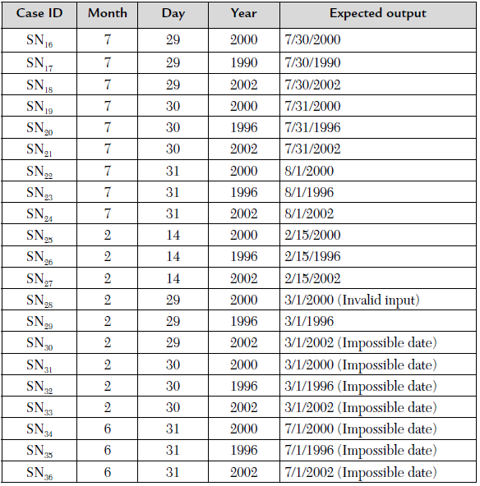
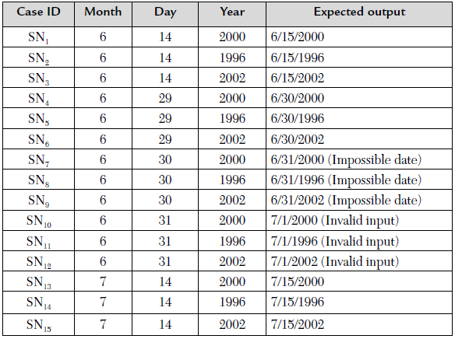
Black Box Testing
Equivalence Class Testing
Total 3*4*3 = 36 Test Cases
- For SR (Strong Robust), 2 invalid cases will be added for each input, hence total Test cases would be 150.

Slide 36
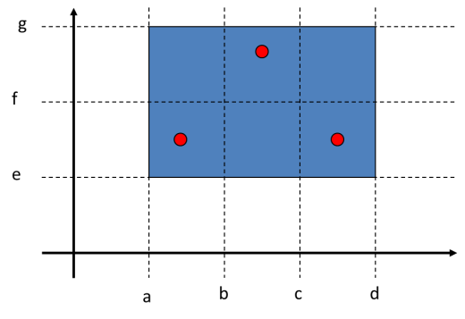

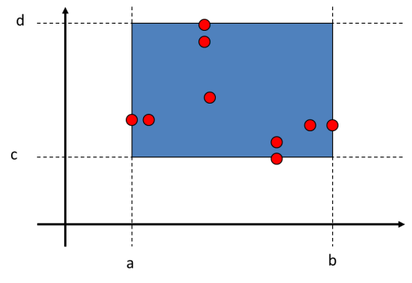
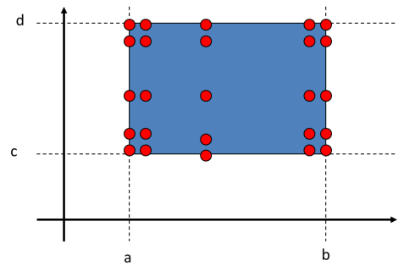


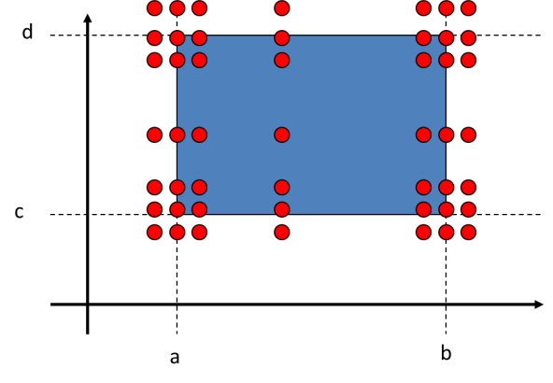
EC & BVA
BVA
Weak Normal
Weak Robust
Worst Case Analysis
Strong Normal
Strong Robust

